Slide 1
Welcome!
We will begin shortly…
Virtual Meeting Schedule
6:00 – 6:10 | Welcome
6:10 – 6:45 | Presentation
6:45 – 7:00 | Presentation Q & A (General)
7:00 – 7:45 | Zoom Breakout Rooms
7:45 – 8:00 | Come Back Together/Wrap-Up

Slide 2
MSA Professional Services with City of Madison Engineering Division May 12, 2022
Greentree/McKenna
Watershed Study
Public Information Meeting No. 3
Please Note: This meeting is being recorded. It is a public record subject to disclosure.
By continuing to be in the meeting, you are consenting to being recorded and consenting to this record being released to public record requestors.

Slide 3
Meeting Technical Housekeeping
This meeting will be recorded and posted to the project page.
All attendees should be muted to keep background noise to a minimum.
Use the “chat” button for technical issues with meeting to troubleshoot with staff to assist.
Use the “Q and A” button to type questions about presentation. Questions will be answered live after the presentation.
Inappropriate questions may be dismissed.
Use the “raise your hand” button to verbally ask your question. You will be prompted to unmute when it is your turn.

Slide 4
This meeting is being recorded.
It is a public record subject to disclosure.
By continuing to be in the meeting, you are consenting to being recorded and consenting to this record being released to public record requestors.

Slide 5
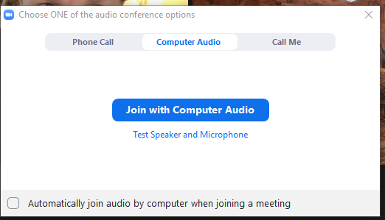
How to Participate
Make sure to join audio

Slide 6
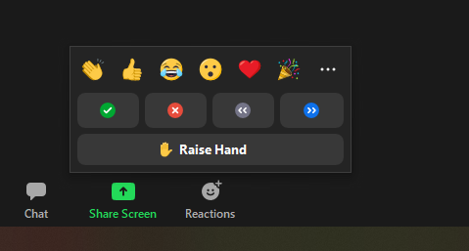
How to Participate
Raise your hand to be unmuted
for comments or ask additional questions.

Slide 7
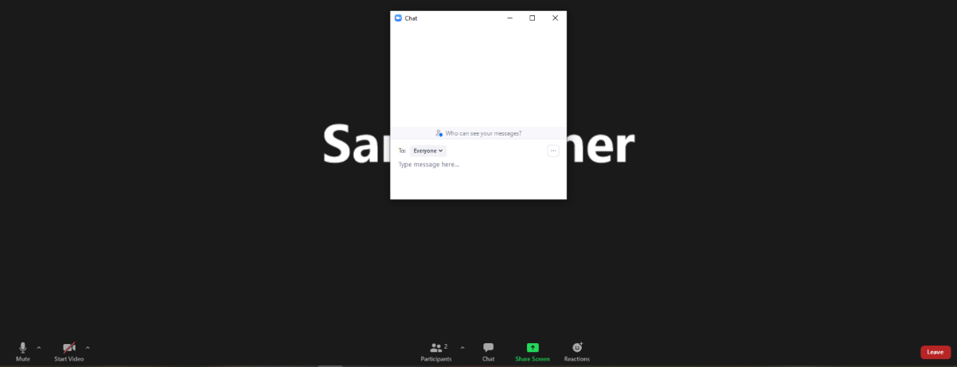
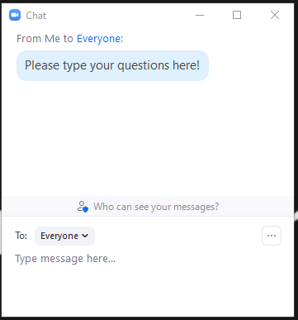
How to Participate
Use chat if you have technical
issues or a question for the panelists.

Slide 8
How to Participate
When you are ready to leave the meeting
To leave the meeting click here

Slide 9
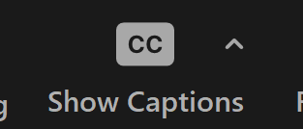
Closed Captioning
If you’d like to enable closed captioning, click “show closed captions” button on the bottom of the screen.
This may already be enabled. If this is not enabled, click the button to allow closed captioning.

Slide 10
Evening Overview
Welcome (Hannah Mohelnitzky, City of Madison)
Presentation (Eric Thompson, MSA Professional Services)
Q&A (facilitated by Hannah Mohelnitzky, City of Madison)
Submit questions through Zoom “Chat”
To find the Zoom Chat Box, hover over the edge of your screen. A toolbar will appear, and you can click on “Chat”
Questions answered at the end of the Presentation
Wrap Up (Hannah Mohelnitzky, City of Madison)
Breakout Groups (MSA and City of Madison staff)
An option to join breakout groups will appear on your screen

Slide 11
Presentation Outline
Definitions of commonly used terms
Study location
Watershed study schedule
Flood mitigation targets
Inundation mapping
Proposed solutions development process
Proposed solutions
a. Standalone projects
b. Local storm sewer
Implementation and cost
Why aren’t all flood targets met?
Next steps

Slide 12
Contact Information & Resources
Project Manager: Matt Allie, mallie@cityofmadison.com
Public Information Officer: Hannah Mohelnitzky, hmohelnitzky@cityofmadison.com
Project Webpage: https://www.cityofmadison.com/engineering/projects/greentree-mckenna-watershed-study
Sign-up for project email updates on the website
Report flooding, past or current on the Report Flooding form
Learn ways to protect your property from flooding with on-site fixes
New Flooding Website: www.cityofmadison.com/flooding
Everyday Engineering Podcast
Facebook – City of Madison Engineering
Twitter – @MadisonEngr
Provide your feedback! https://www.cityofmadison.com/news/survey-open-city-engineering-works-to-prioritize-flood-projects

Slide 13
Zoom Breakout Rooms
Join a Zoom Breakout Room Session
Window will pop up where you can select which group you’d like to join
If a window doesn’t pop up, look for a button on the bottom that says “Breakout Rooms.” Click the button and room options will appear.

Slide 14
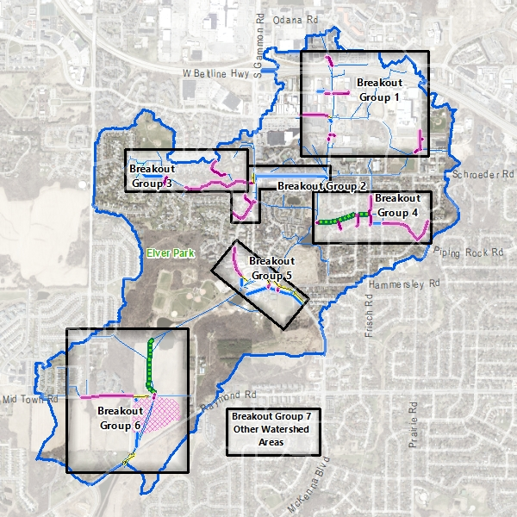
Breakout Groups
Struck/Seybold/Watts and Forward Dr. Reconstruction Projects
Schroeder Rd. and New Washburn Way Reconstruction Projects
Valhalla Way Reconstruction and High Point Estates Pond
Piping Rock Rd., Chapel Hill Rd. and Greenway Reconstruction
McKenna Blvd. Storm Sewer Improvements
Elver Park Greenway and Marty Road/Mid Town Road Regional Pond
Other Watershed Areas

