Slide 1

Public Information Meeting
City of Madison Engineering Division
[Date]
Thank you for attending. We will begin shortly…
Title
Title

Slide 2
Meeting Technical Housekeeping
This meeting will be recorded and posted to the project page.
All attendees should be muted to keep background noise to a minimum.
Use the “chat” button for technical issues with meeting to troubleshoot with staff to assist.
Use the “Q and A” button to type questions about presentation. Questions will be answered live after the presentation.
Inappropriate questions may be dismissed.
Use the “raise your hand” button to verbally ask your question. You will be prompted to unmute when it is your turn.

Slide 3
This meeting is being recorded.
It is a public record subject to disclosure.
By continuing to be in the meeting, you are consenting to being recorded and consenting to this record being released to public record requestors.

Slide 4
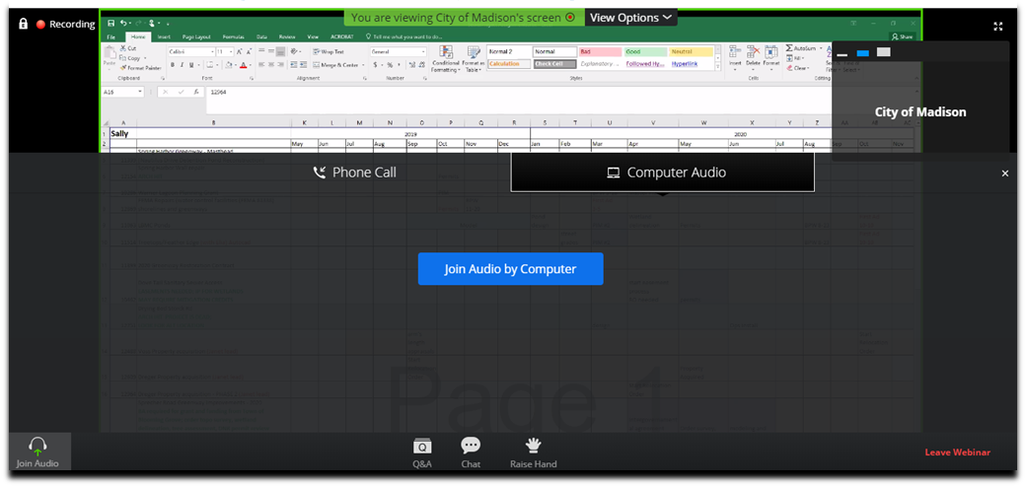
Public Information Meeting by City of Madison Engineering Division
May 7th, 220
How to Participate
Make sure to join audio

Slide 5
Public Information Meeting by City of Madison Engineering Division
May 7th, 220
How to Participate
Raise your hand to be unmuted
For comments or ask additional questions.

Slide 6
How to Participate
Use chat if you have technical issues
or a question for the panelists

Slide 7
Public Information Meeting by City of Madison Engineering Division
May 7th, 220
How to Participate
Use Q/A if you have questions.
We will answer after the presentation

Slide 8
Public Information Meeting by City of Madison Engineering Division
May 7th, 220
How to Participate
To leave the meeting click here

Slide 9
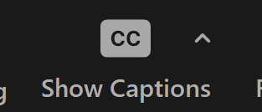
Closed Captioning
If you’d like to enable closed captioning, click “show closed captions” button on the bottom of the screen.
This may already be enabled. If this is not enabled, click the button to allow closed captioning.

Slide 10
Project Location

Slide 11
Existing Conditions
Item | Existing Condition
Last Surfaced
Pavement Surface Evaluation & Rating
Curb Rating
Width
Surface
Sidewalk
Sanitary
Water
Storm

Slide 12
Proposed Design

Slide 13
Public Right-Of-Way

Slide 14
Construction & Access

Slide 15
City & County Funding

Slide 16
Assessment Policy & Costs

Slide 17
Project Schedule
Date: Advertise for Bids
Date: Mail Estimated Assessments, Public Hearing Notice
Date: BPW Public Hearing
Date: Common Council Hearing
Date: Begin Construction
Date: End Construction

Slide 18
Contact Information & Resources
Engineering
  Title, Name, Phone, Email
  Title, Name, Phone, Email
  Title, Name, Phone, Email
Project Website: cityofmadison.com/engineering/projects/?????
  Sign-up for project email updates on the website
  Updates on closures & work progress will be posted to the project website
  Recording for this meeting will be posted on project webpage
Facebook – City of Madison Engineering
Twitter – @MadisonEngr
Engineering Podcast: Everyday Engineering on iTunes, GooglePlay

